Slide 1




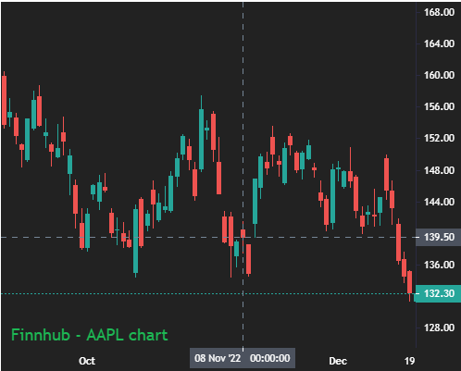


From:
-
Stocks :
To:
SFTCF
SEIX
SFTCF
SFTCF - SOFTCHOICE CORP
ASAD - VIRTUS SEIX SENIOR LOAN ETF
DDSE - HARDCHOICE CORP
SEIX - VIRTUS SEIX SENIOR LOAN ETF
Financial Ratios
Company | Current Ratio | Sales Per Share | Nett Margin
STCF | 1.599 | 2.221 | 323.1
ASDR | 1.599 | 2.221 | 323.1
FFFE | 1.599 | 2.221 | 323.1
Select stock on the left
Search…

